Slide 1


Your Company Managed Services

Slide 2
Why is managed services right for me?
Every federal contractor needs a support team with the extensive experience in government contracting requiring subject matter expertise in areas, such as, financial reporting, cost accounting, HR, contract and project management and security, including:
Accounting: SMEs (CFO, Controllers & Bookkeepers) with background in government accounting to ensure the funds provided by the government are properly managed and that accurate record keeping is in place to support government audits.
Human Resources (HR): SMEs (HR Specialists) with background in human resources management. The HR specialists have expertise in all aspect of HR from recruiting, developing HR policies, and have worked with DOL to understand the details of compliance.
Contract Management: SMEs (contract management and administrators) with background in managing the entire lifecycle of government contracts. Including tracking and managing deliverables, funding and modifications.
Project Management: SMEs (Project Managers and Analysts) with background in developing project plans, including budgets, schedules and generating project job cost reports.
Security: SMEs (policy and security analysts) with background in cybersecurity requiring an understanding of emerging security requirements such as CMMC.
Early stage federal contractors can not break the bank directly hiring these highly unique and expensive resources and must meet this requirement by leveraging managed services and a fractional resource model.

Slide 3
What does my teams staffing plan entail?
Role | Responsibilities
Chief Financial Officer | Overall responsibility for company management reporting and guidance with extensive experience in GAAP, DCAA, CAS, FAR and SCA.
Controller | Overall responsibility for development of policies and procedures, staff work product review, maintaining human resource records, reviewing and approving journal entries, reviewing and approving customer invoices including ITD funding and ceilings, month end closings, preparation of key performance indicators, preparation of budgets and forecasts and preparation of management reporting packages.
PM/Contract Management | Responsible for contract and project maintenance including Base and Option Periods, Modifications, Ceilings and Funding, ITD and YTD, Labor Categories Bill Rates, Task, Charge Codes, Work Authorizations and Budgets.
Bookkeeper | Responsible for Bank reconciliations, subsidiary and ledger reconciliations, adjusting journal entry and maintenance.
Timecards and Payroll interface | Responsible for timecard timeliness and accuracy, payroll processing and payroll payments.
AP Clerk | Responsible for entering and maintaining coded vouchers, maintaining vendor records, processing approved payments, reviewing expense reports for accuracy and approval, maintaining the accuracy of ap voucher register and ap cash requirements.
AR/Billing Clerk | Responsible for maintaining customer master records, generation of customer invoices, submittal for payment and accurately processing customer payments to appropriate.

Slide 4
What services are included by AtWork?
Chief Financial Officer Overall responsibility for company management reporting, compliance and guidance with extensive experience in GAAP, DCAA, CAS, FAR and SCA.
Contract Management AtWork will setup new contracts including base and option years, clins and slins, ceilings, funding, billing and ITD history. Your Company will provide the necessary contract information in the format requested and within the timeframe requested by AtWork and will review and approve the entered contracts. AtWork will manage contract modifications with the Your Company team as they occur. AtWork will perform periodic contract reviews with the Your Company team to review for accuracy and approval.

Slide 5
What services are included by AtWork? Continued
Project Management AtWork will setup new projects. Your Company will provide the necessary project information in the format requested and within the timeframe requested by AtWork. AtWork will process approved timecards, expense reports, purchase orders and project summary reports to be reviewed with Your Company management. AtWork will manage and review project modifications with the Your Company team as they occur. AtWork will perform the maintenance of item catalogs, labor categories, charge codes, work authorizations, chart of account codes and account mappings for existing and new contracts and projects.
Third Party Payroll Processing AtWork will record the payroll and taxes as calculated by Your Company’s payroll service into OneLynk and reconcile to the monthly or quarterly reports. AtWork will not make payroll tax deposits or prepare payroll tax returns as this is the responsibility of the payroll processing company. Your Company and its payroll service provider will be responsible for payroll calculations, returns and deposits.

Slide 6
What services are included by AtWork? Continued
Finance Planning and Accounting AtWork will perform the setup of new customers. AtWork will prepare the monthly customer billing and invoices and meet with Your Company. management to review and remit the approved invoices to customers. AtWork will perform the setup of new vendors , assist in the selection of invoices to be processed for payment and meet with management to remit approved invoices for payment. AtWork will perform the setup of HCM records for Your Company approval. Each month AtWork will reconcile Your Company checking accounts with the bank statements for proper account balances and to identify reconciling items that may require adjustments to their books and records. AtWork will make adjusting entries directly into OneLynk and identify the source of each adjustment. Your Company management is responsible for reviewing and accepting the adjusting entries and understanding the nature and impact of these entries to your books and records. AtWork will reconcile credit card statements, and loan balances using information Your Company provides. Upon completion of all reconciliations and posting of adjustments AtWork will meet with Your Company management to review OneLynk Management reports to discuss actual vs expected performance, corrective actions, open items and or alternative strategies.

Slide 7
The OneLynk Platform and our Process
AtWork leverages our OneLynk platform to deliver our managed services.
Our patented tools and processes allow us to onboard our clients in an extremely efficient manner.
OneLynk is the most comprehensive DCAA compliant accounting system available on the market today.

Slide 8
Enterprise Business Functions Completeness of Solution
Financial
Sales
Human Capital
Operations
Productivity
General Ledger
Accounts Payable
Accounts Receivables
Payment Register
ACH (bank transfers)
Paper Checks
Basic Invoicing
Financial Dashboard
Sales Order (SOs)
Inventory
SO Invoicing
Shipping Notices
Sales Returns
Sales Dashboard
Resource Management
Benefits Management
Employee Self Service
Manager Self service
Recruit2Hire
Appraisals
Payroll
My Dashboard
HCM Dashboard
Contracts & Mods
Contract Bids
Projects & Mods
Job Estimating
Timesheets
Expense Reports
Purchase Requisitions
Receiving/Returns
Inventory
Material Orders
Project Invoicing
Project Dashboard
Spending Dashboard
Security Compliance
Org Management
Role-based security
Multi-factor authentication
Worklist/Approvals
MyTask TODOs
Documents
Advanced BI

Slide 9
Quick Onboarding Configuration – Solution Manager
Financial Setup
Training
Financial
Core Setup
Incremental Configuration
Pre-configured rate models for chart of accounts & financial calendars
General Ledger (initial and target balances)
Generate indirect rates using Initial and target GL account balances
Default setting using system parameters
Org management
Users and role-based security
Default account groups for recording transactions
Default workflow policies
Customers & Vendors
Contract (if applicable)
Project (ITD/YTD balances)
Configure charge codes (direct and Indirects)
Timesheets & expense reports
Webinars (90 min sessions)
Overview (60 min session)
Accounting (90 min session)
Timesheets & Expense Reports (90 min session)
Contracts (90 min session)
Projects (90 min session)
Procurement (90 min)
Our configuration allows a quick ramp up for Companies

Slide 10
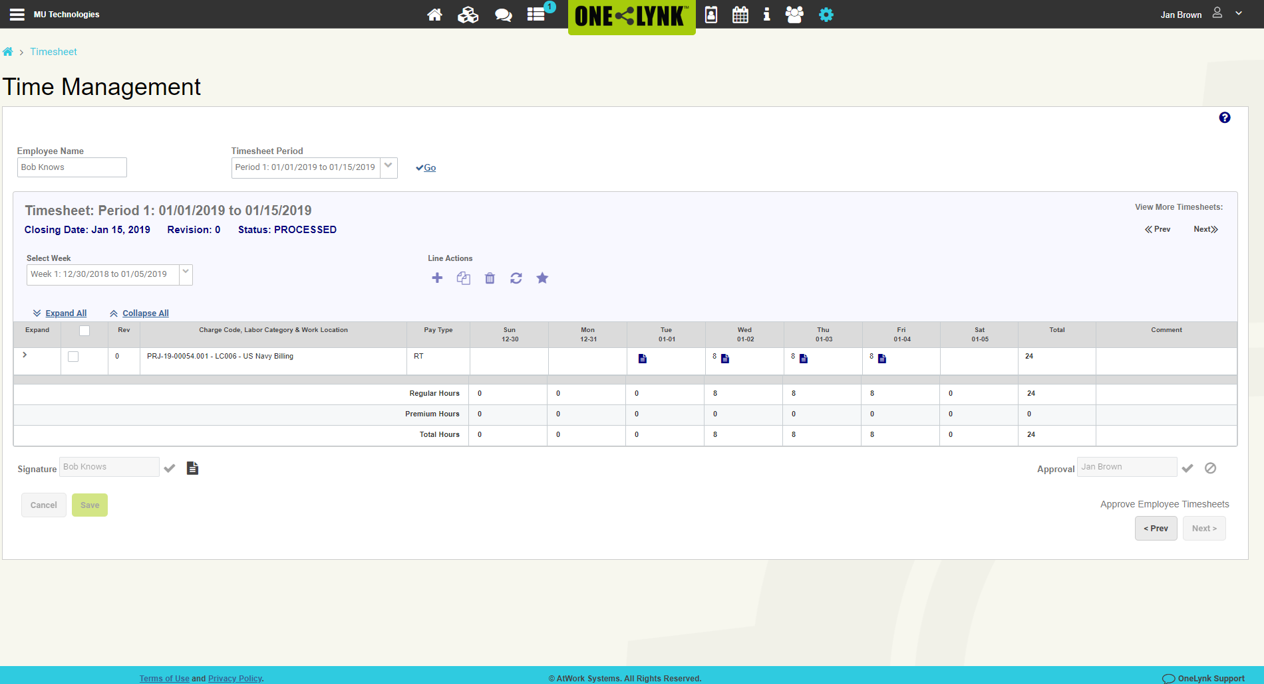
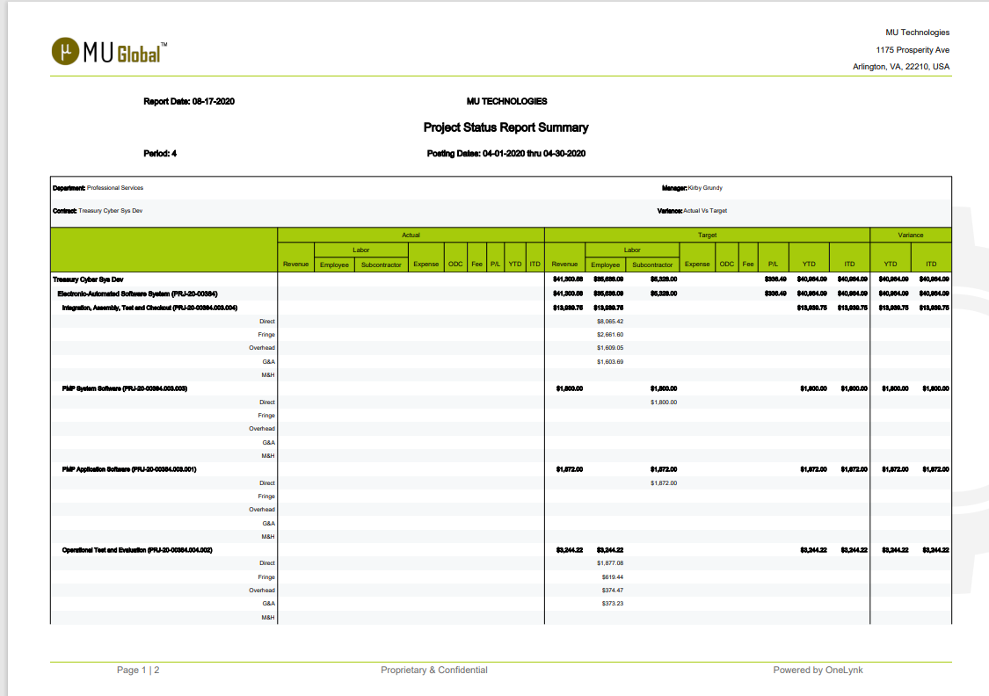
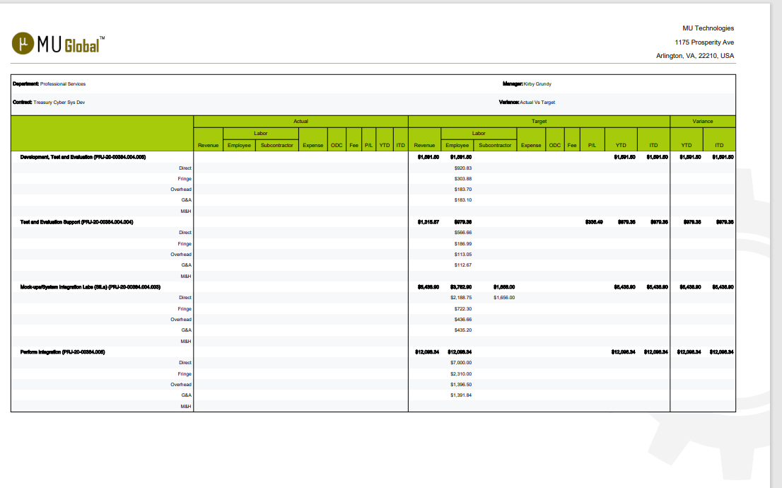
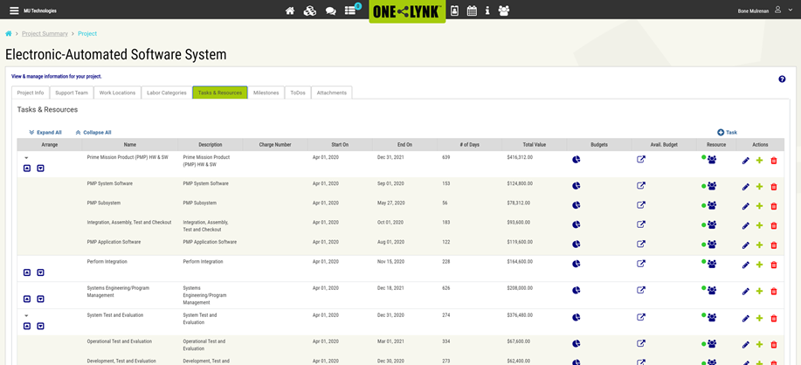
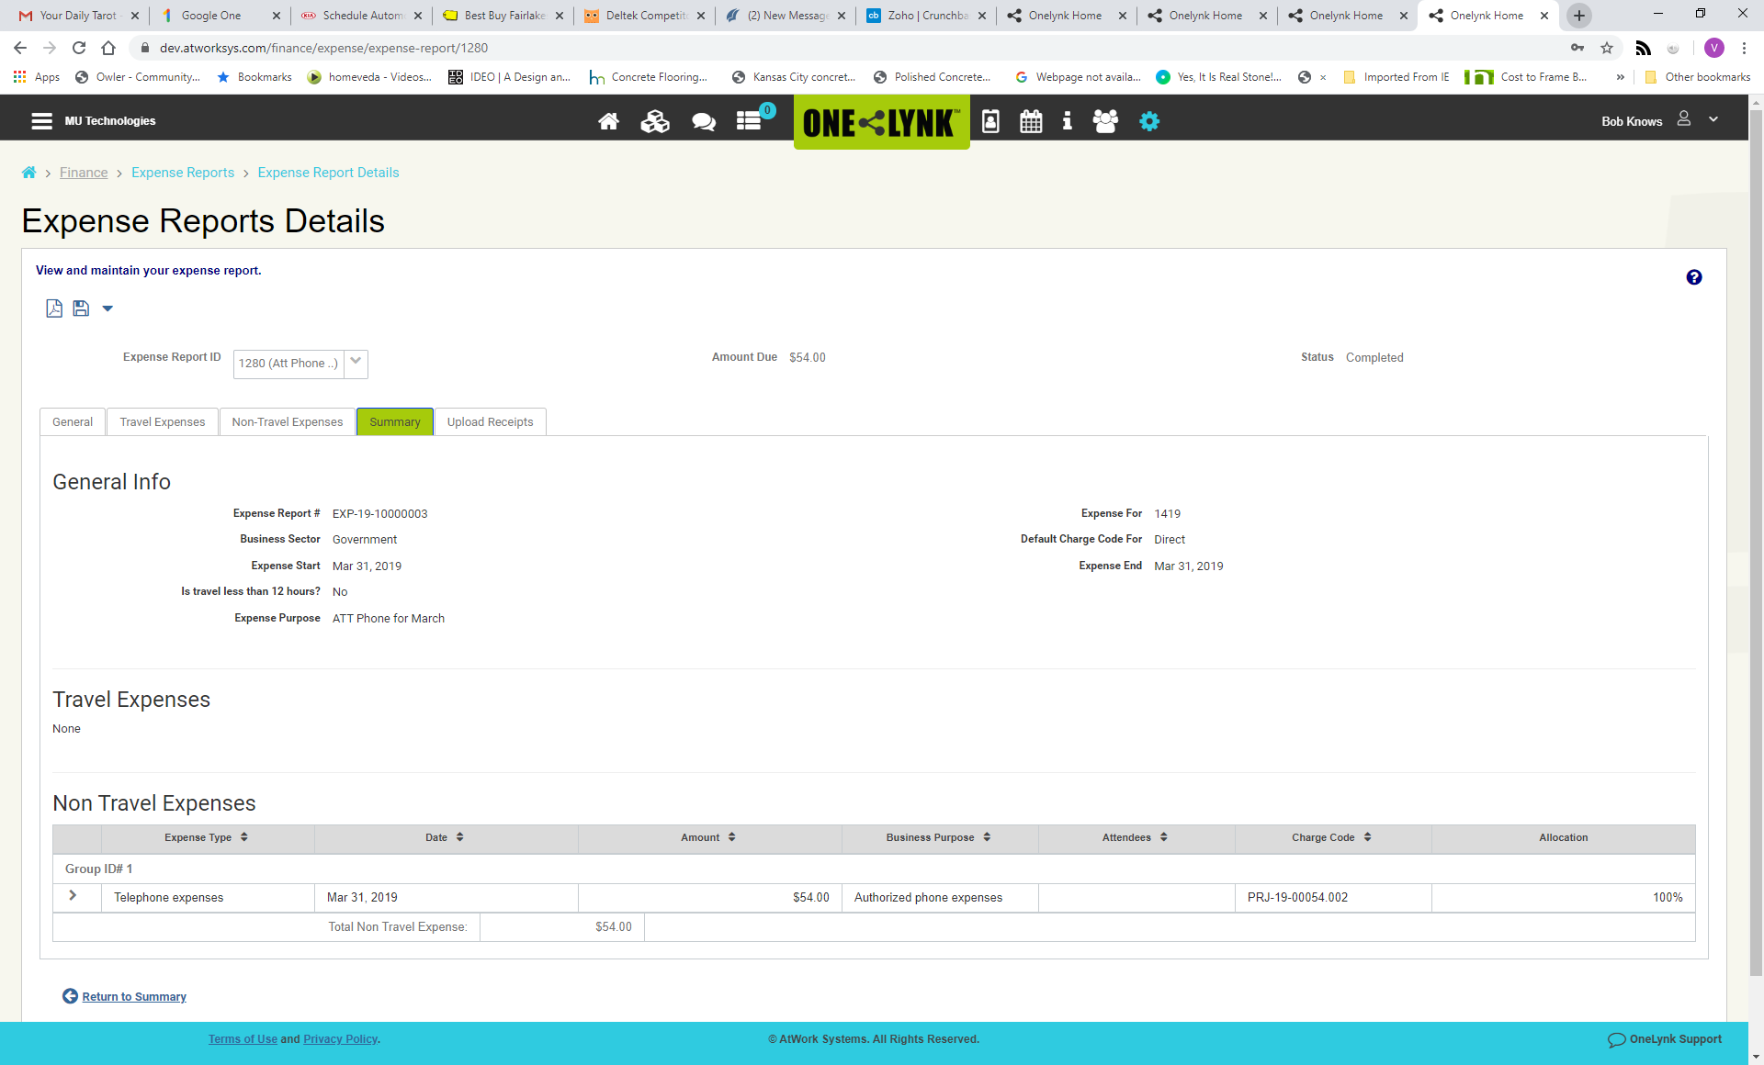
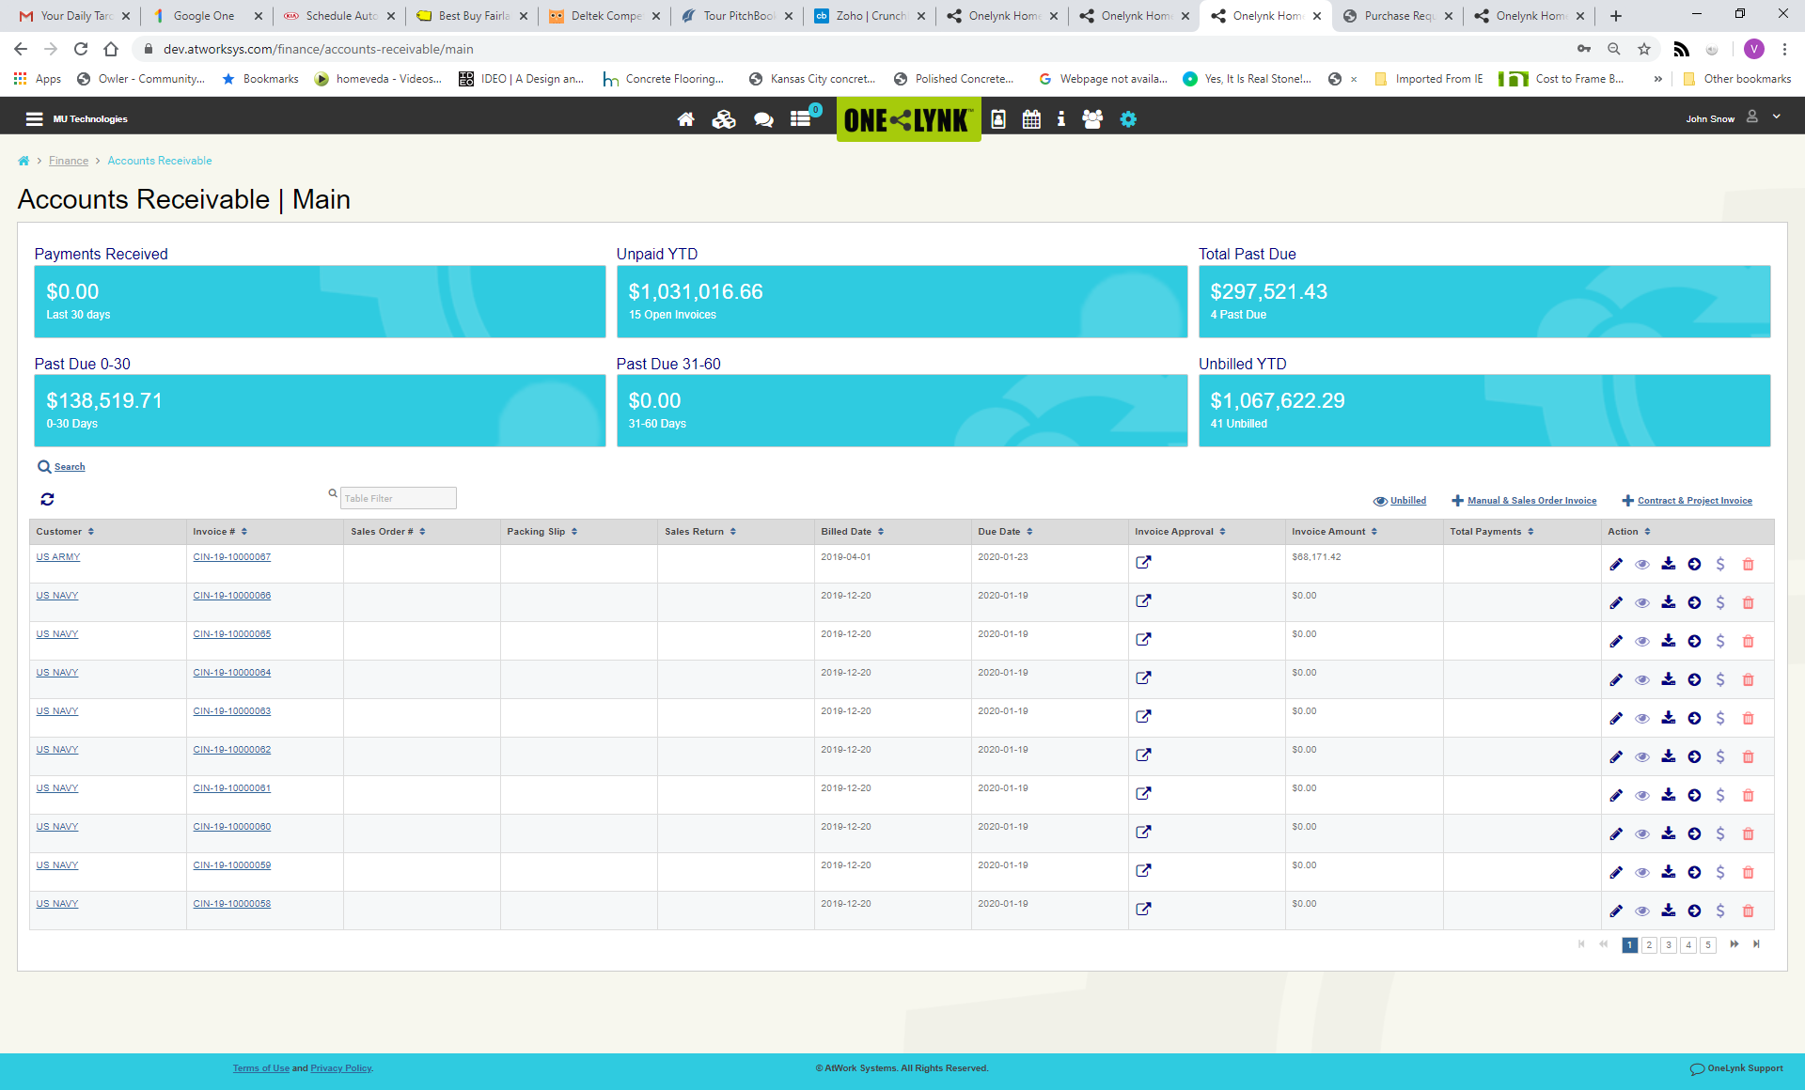
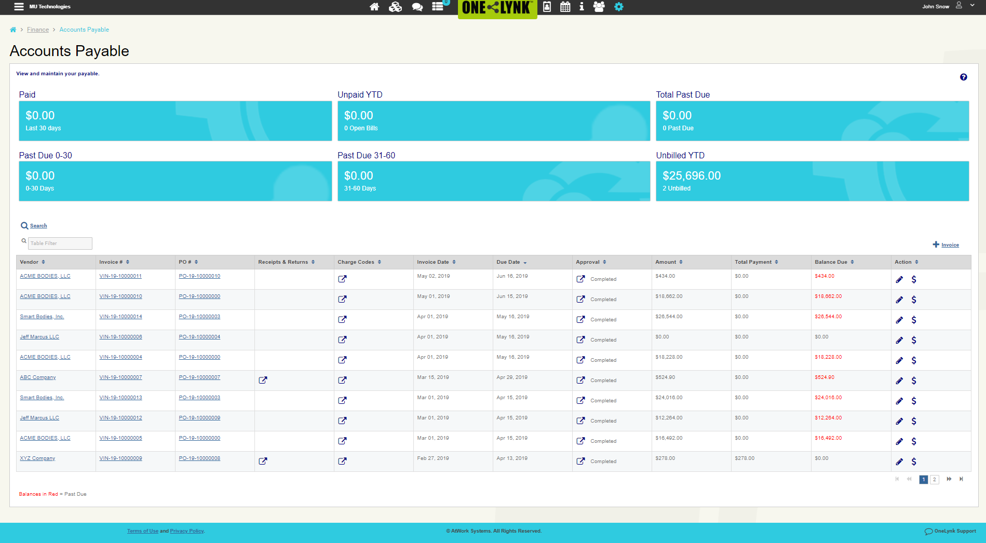
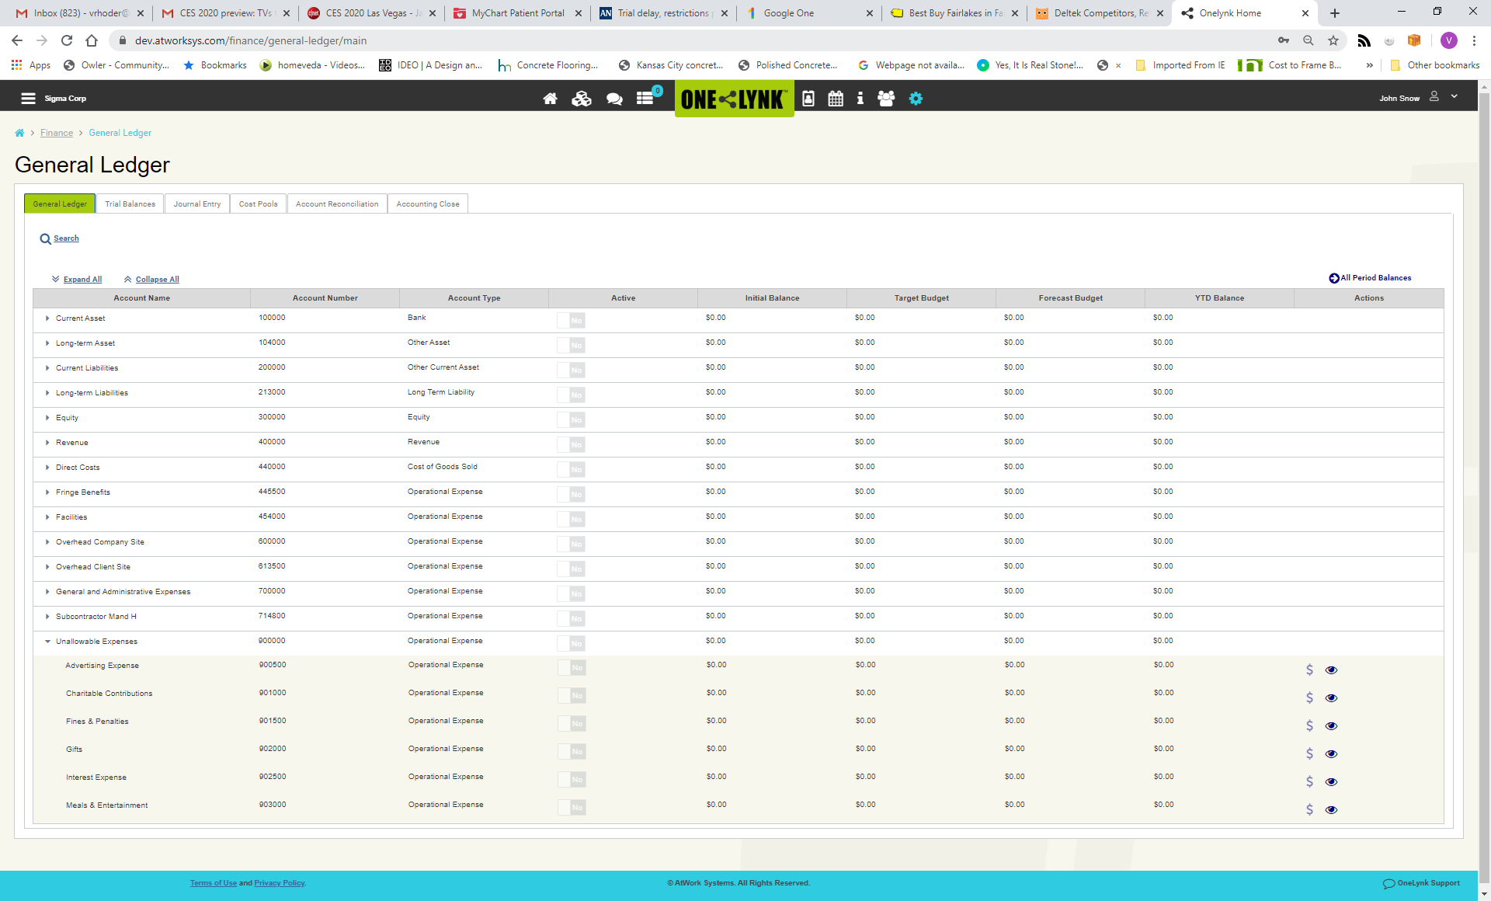
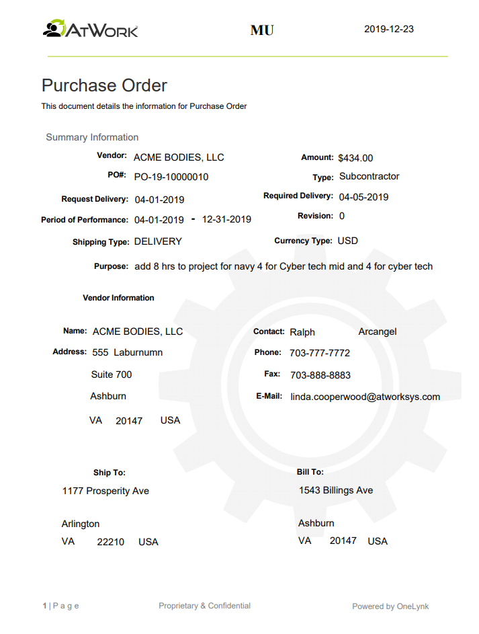
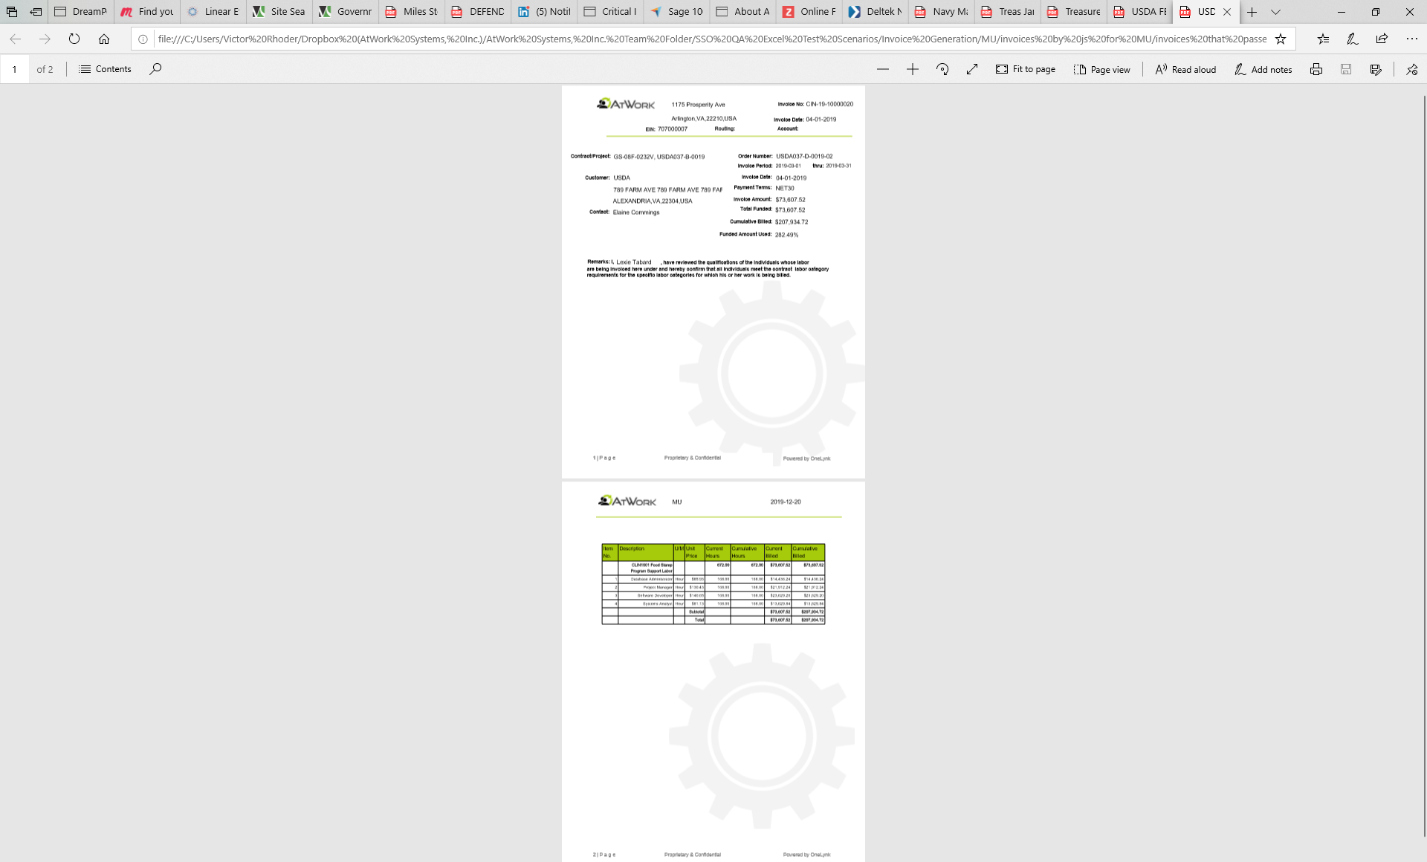
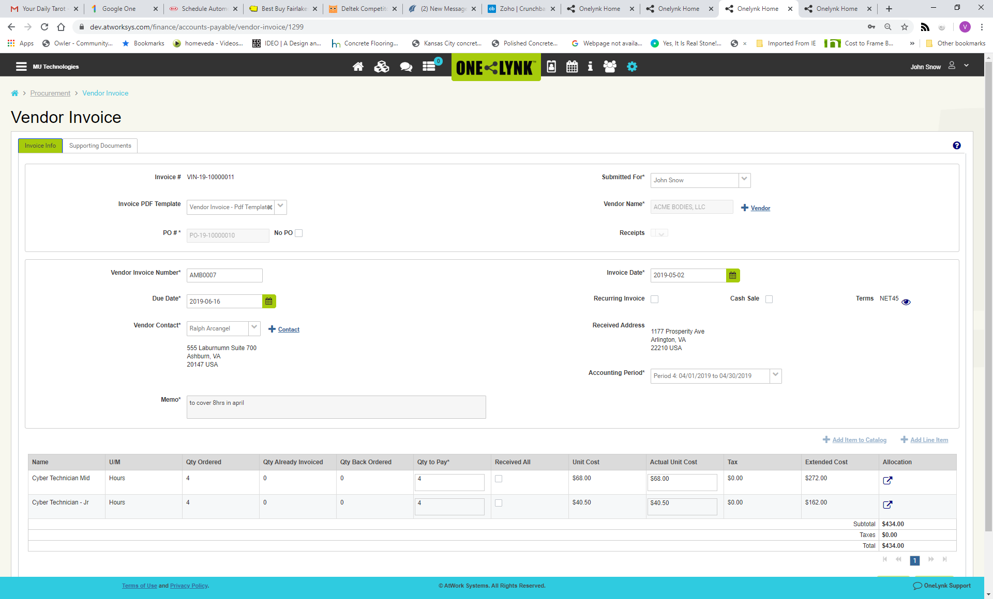
Complete Project Integration with Business Operations
Timesheets
Status Reports
SEAMLESS INTEGRATION STREAMLINES OPERATIONS
Project WBS
Expense Reports
GL/AP/AR
Purchase Orders
Customer Invoices
Vendor Billing

Slide 11

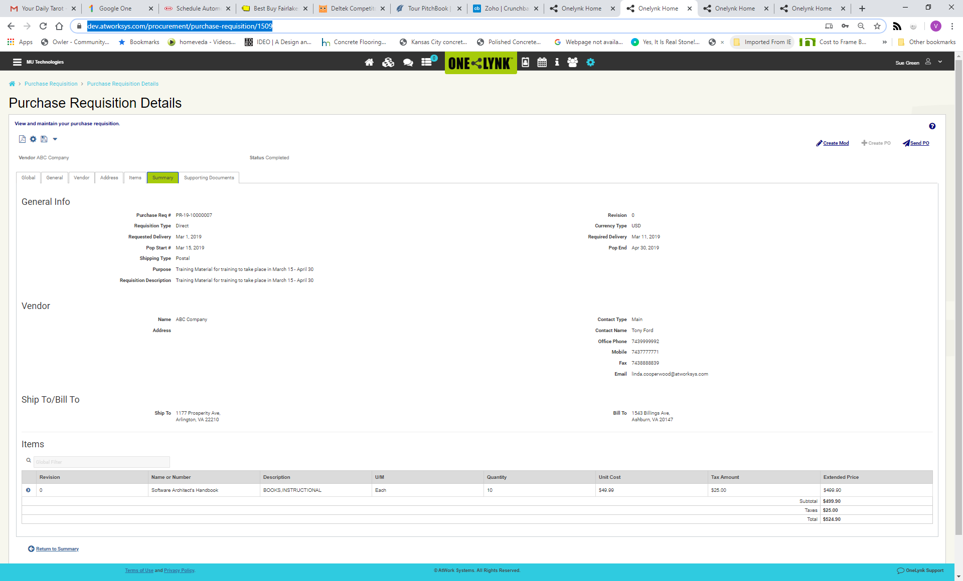
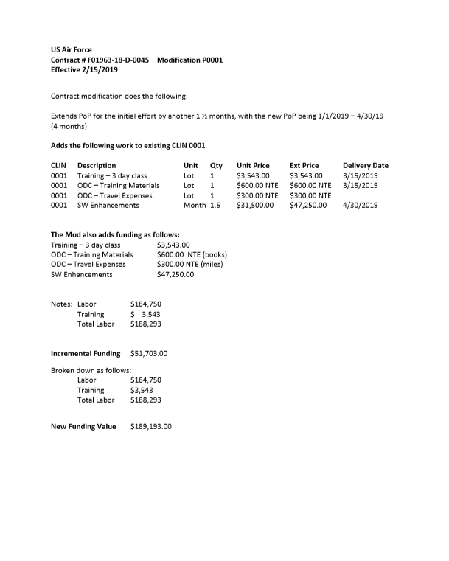
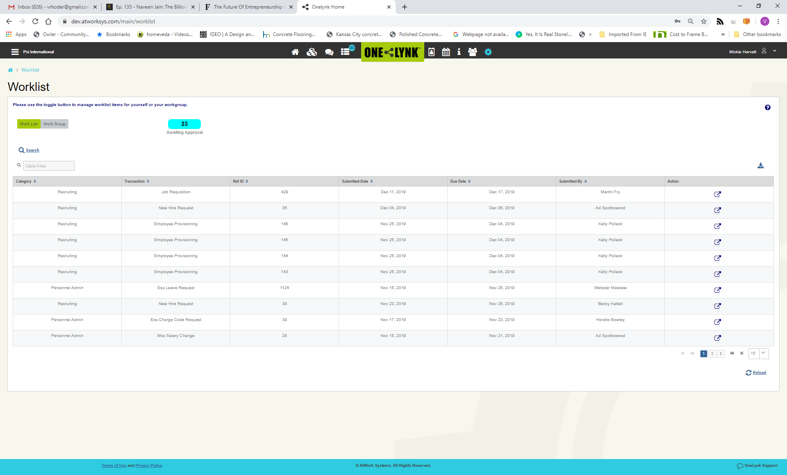
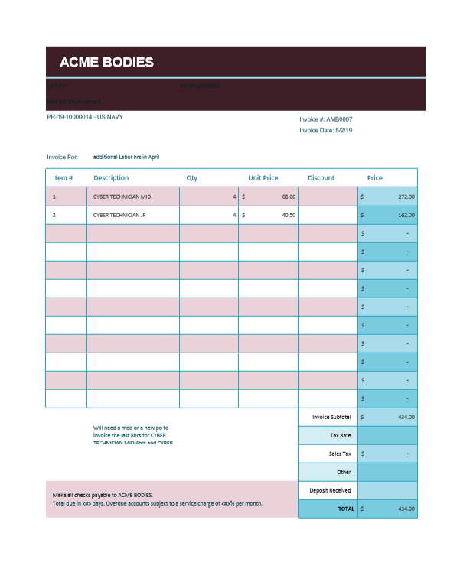
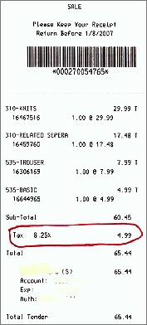
Enforce Consistent Enterprise-Wide Processes and Oversight
Business Processes
Workflow Policies
Manager To Do Lists
Supporting Documents
Approval Policy
Authorization Policy
Escalation Policy
Delegation Policy
Electronic Transactions
  Purchasing
  Invoicing
  Timekeeping
  Expense reports
  Payables
Worklist Summary
Tailored Business Rules
Embedded Attachments
Enforces ISO compliant, efficient, and repeatable processes

Slide 12
Our Integrated Compliance Lowers Costs and Risks
Core Features
Supports GovCon Contractors
Compliant Accounting
DCAA/DCMA/DFAR/CAS/JTR
Prime Contractors
Secured Operations
NIST and CMMC Security Alignment
Cost Plus Contracts
Subcontractors
Certified Processes
CMMI, ISO9001 Certification Alignment
GovCon and Commercial Enterprises
Compliant HR
Labor Compliance and SCA
Compliance Reporting
BI for Flexible Compliance Reporting
DESIGNED FOR ACCOUNTABILITY, VISIBILITY, AUDITABILITY AND SECURITY

